Slide 1
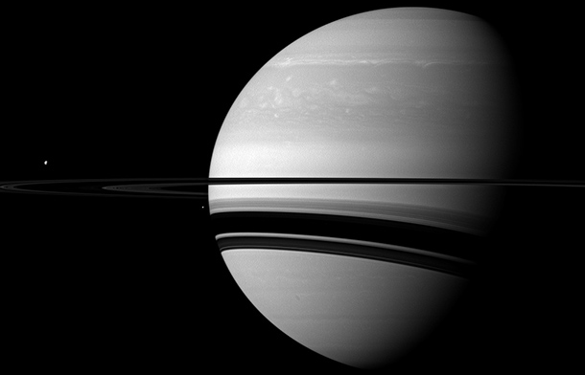
Zonal Jets
Adam P. Showman
University of Arizona
on sabbatical at Peking University

Slide 2
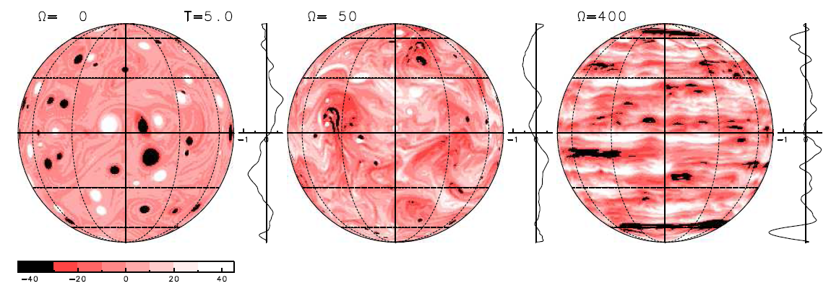
2D models appropriate to Jupiter and Saturn show that rotation causes zonal banding
Hayashi et al. (2000)
See review in Vasavada & Showman (2005, Rep. Prog. Phys. 68, 1935)

Slide 3
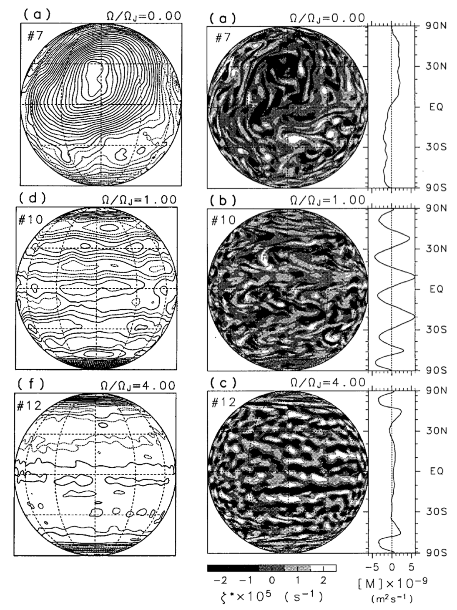
2D models appropriate to Jupiter and Saturn show that jets can form in rotating atmospheres forced by small-scale turbulence
Nozawa & Yoden (1997)

Slide 4

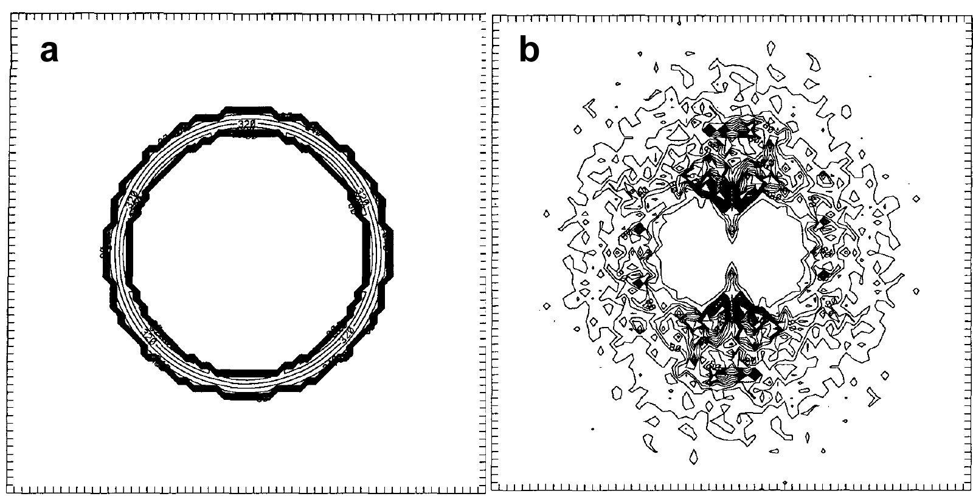
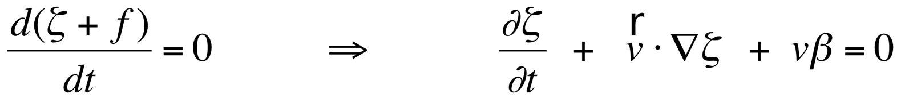
Emergence of banding
U²/L²
Uβ
Vallis and Maltrud (1993)
Simple scaling suggests the nonlinear term and beta term are comparable at a scale
L_{R} = (U/β)^{1/2}
called the Rhines scale. Because the transition is anisotropic, banding should emerge.

Slide 5
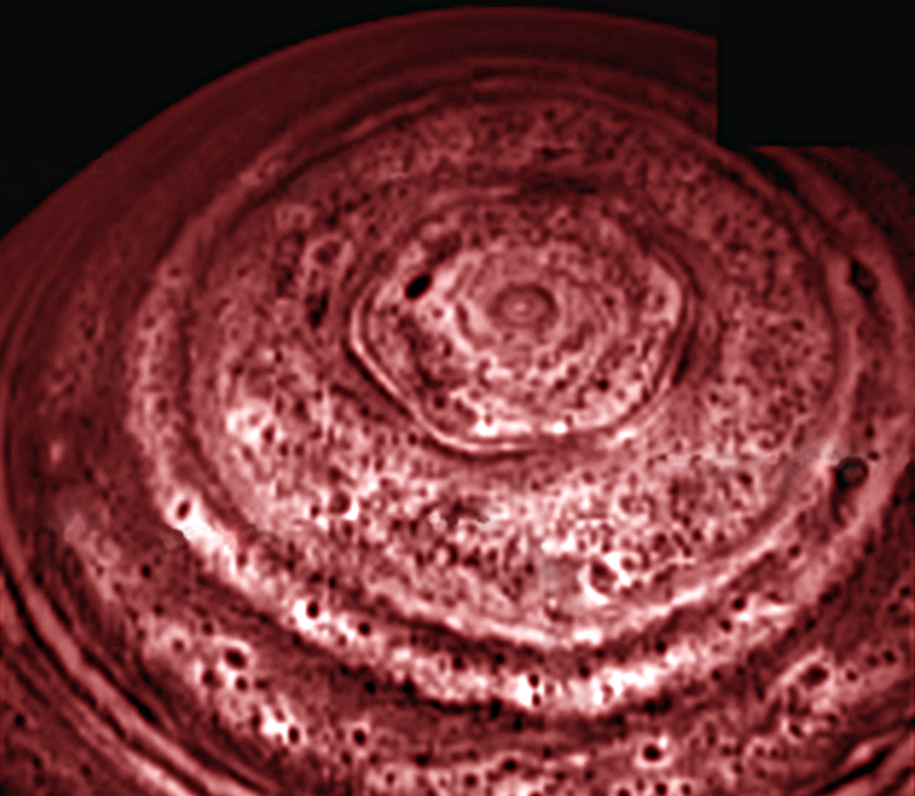
Saturn 5 μm emission illustrates scale-dependent anisotropy

Slide 6
Mechanisms of extratropical jet formation: role of Rossby waves
Group
propagation
In the extratropics, regions of Rossby wave generation correspond to eastward eddy-driven jets. Regions of Rossby wave damping correspond to westward flow.
Phase
propagation
Phase
propagation
Group
propagation

Slide 7
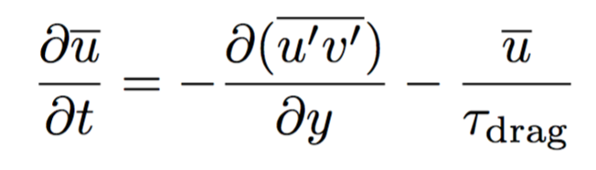
Mechanisms of jet formation: role of Rossby waves
Group
propagation
Phase
propagation
u’v’<0
The eddy acceleration term is positive (eastward) in the region of Rossby wave generation, and negative (westward) in the region of Rossby wave damping/breaking.
Phase
propagation
u’v’>0
Group
propagation

Slide 8
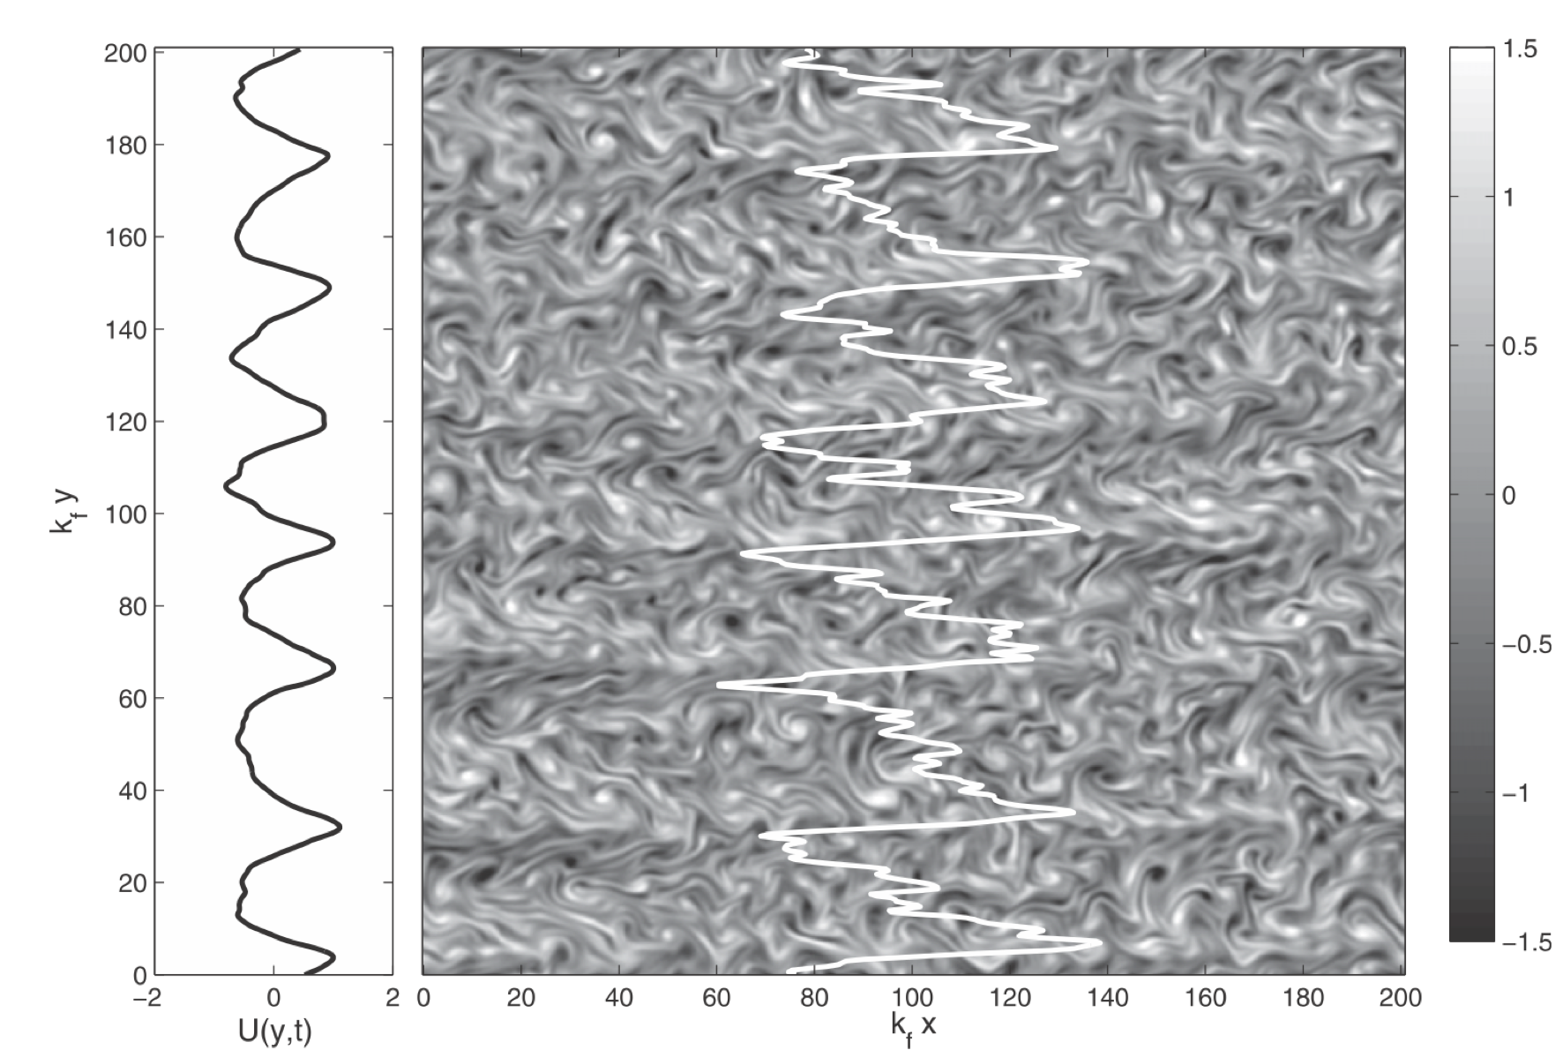
Srinivasan & Young (2012)

Slide 9
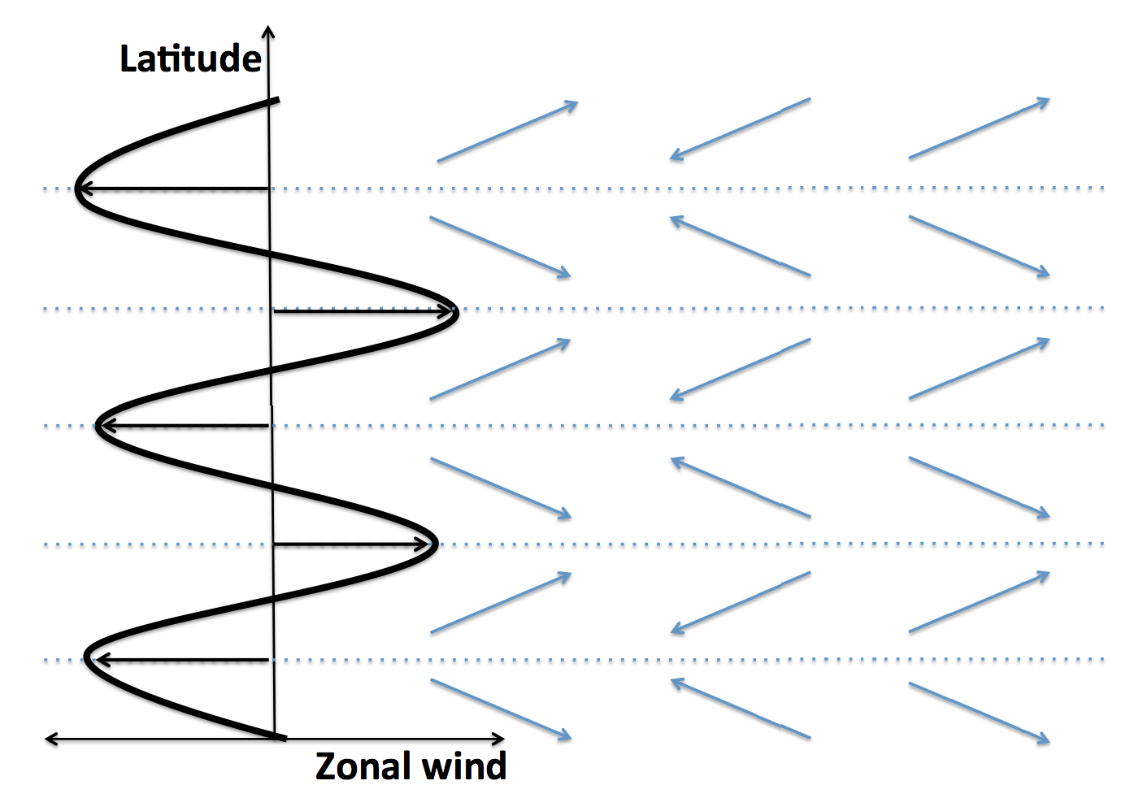
Zonal jets require spatial organization of the turbulence
Jet formation/maintenance requires meridional organization of the turbulence, so that eddies that are north (south) of eastward jets transport momentum southward (northward), into the jet cores
There are no obvious mechanisms external to the jets that could provide this organization. This implies that the organization of the eddies necessary to maintain the zonal jets is caused by the zonal jets themselves.

Slide 10
Need for feedbacks
This idea--that jets organize the eddies to maintain the jets--suggests that eddy-mean-flow interactions play a key role in jet formation. In other words, positive feedback(s) exists in which the presence of the jets induces the eddies to develop the phase tilts necessary to maintain the jets.
The question, then, is what are these positive feedbacks?
In the Earth case, the baroclinic zone is at a fixed latitude. This determines where Rossby waves are generated, and since eastward jets occur in regions of Rossby wave generation, this sets the jet latitude. But, on Jupiter and Saturn, random convective forcing probably occurs everywhere. Then, what organizes the Rossby waves so that preferential wave generation occurs at some latitudes and wave dissipation at other latitudes?

Slide 11
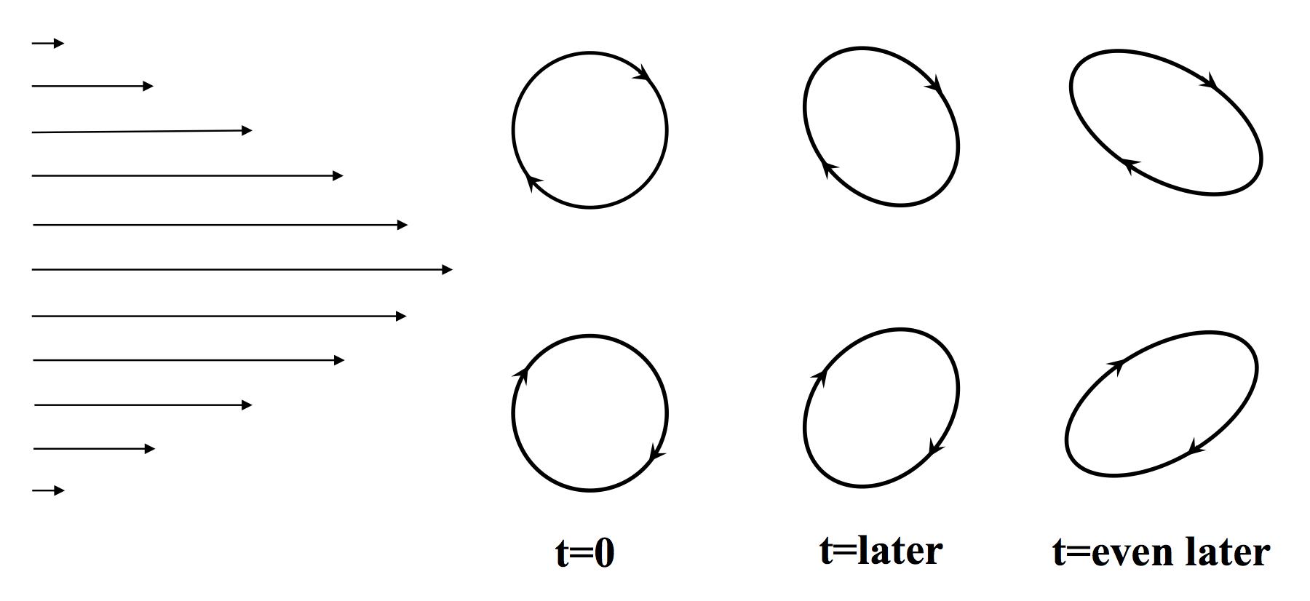
Feedback 1: shear straining
In this idea, the jets shear initially isotropic or quasi-circular eddies, automatically giving them the phase tilts necessary to maintain the jets

Slide 12
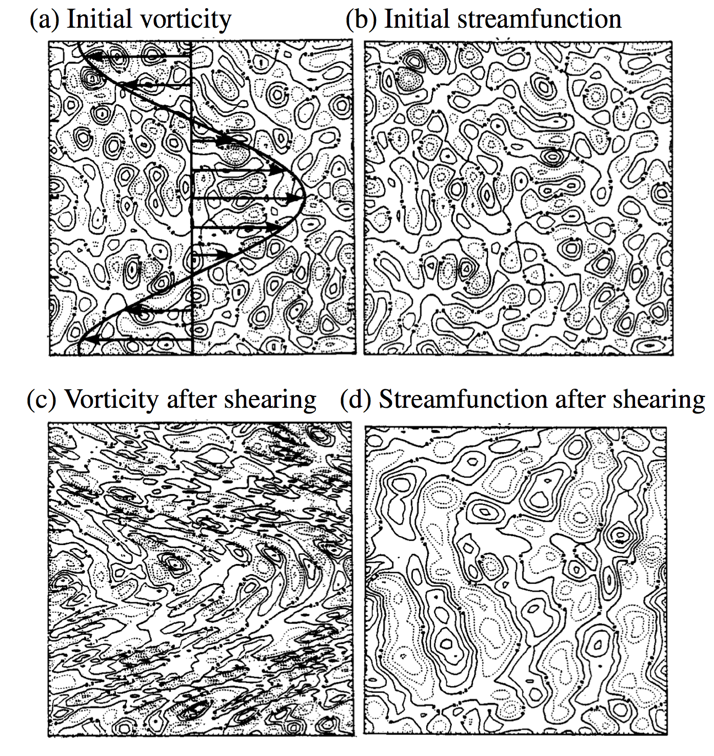
Feedback 1: complications
Problem: the shear straining actually acts only on materially conserved quantities, such as the potential vorticity (PV). Eddy velocities are not a materially conserved quantity, and do not necessarily shear in the expected way.
Shepherd (1987); see also Holloway (2010), Showman et al. (2017)

Slide 13
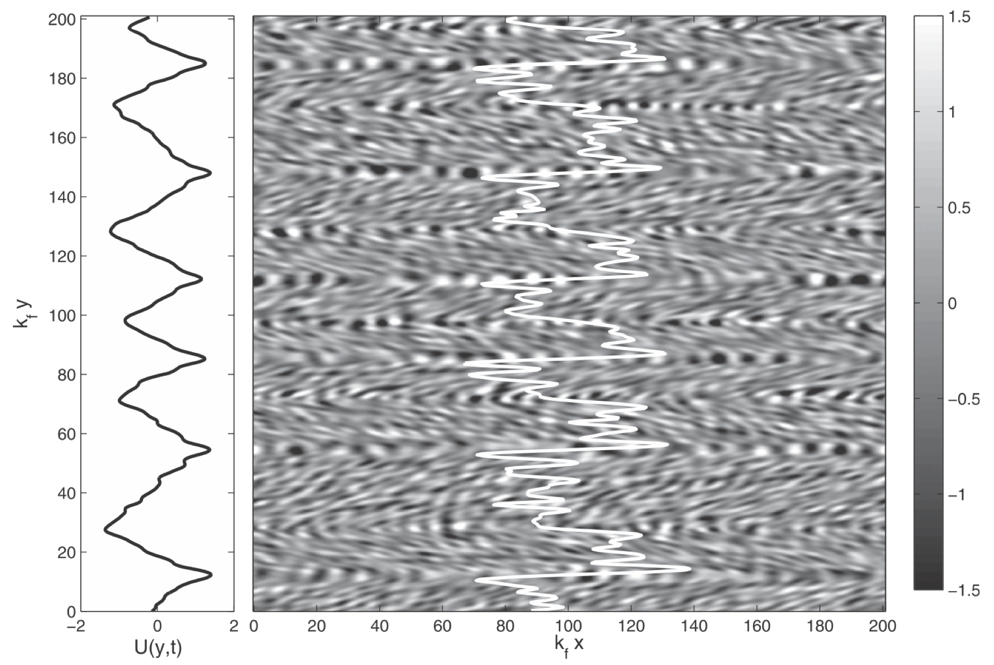
Feedback 1: shear straining
Recent theoretical work shows that shear straining can indeed still work as a positive feedback, despite this problem. More theoretical work is needed.
Here is an example of jet formation due to shear straining in a model where eddy-eddy interactions have been removed:
Srinivasan & Young (2012)

Slide 14
Feedback 2: inhomogeneous mixing of potential vorticity (PV)
Rossby waves break more easily in regions of weak meridional PV gradient than strong meridional PV gradient
Rossby wave breaking mixes the air in latitude, locally homogenizing PV. This reduces the mean PV gradient
This is a positive feedback: Rossby waves preferentially break in regions of weak PV gradient, which makes the PV gradient weaker, which further promotes Rossby wave breaking at that latitude
This results in a “staircase” pattern of constant-PV strips separated by sharp gradients in PV…. which corresponds to a pattern of zonal jets!
The key point is that jets can spontaneously emerge--even if the convective stirring that generates Rossby waves is not spatially organized
see, e.g., Dritschel & McIntyre (2008)

Slide 15
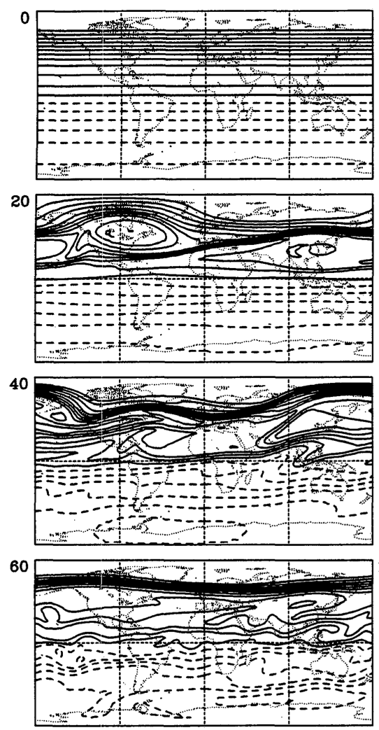
Earth stratosphere example of how Rossby wave breaking leads to PV strips with sharp gradients in between.
Polvani et al. (1995)

Slide 16
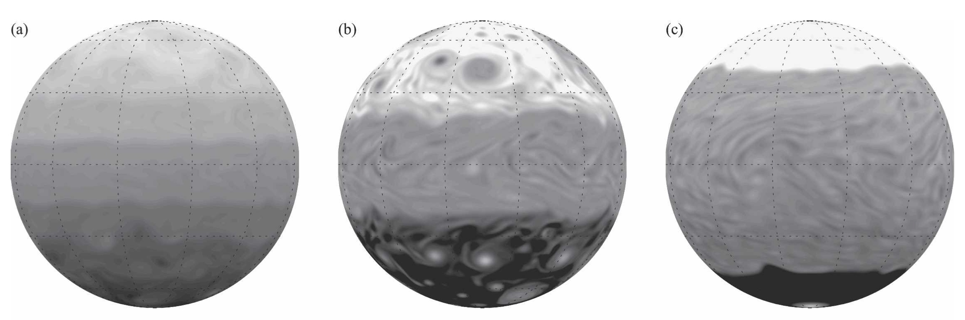
Development of PV staircases in models of giant planet atmospheres
Scott & Polvani (2007)

Slide 17
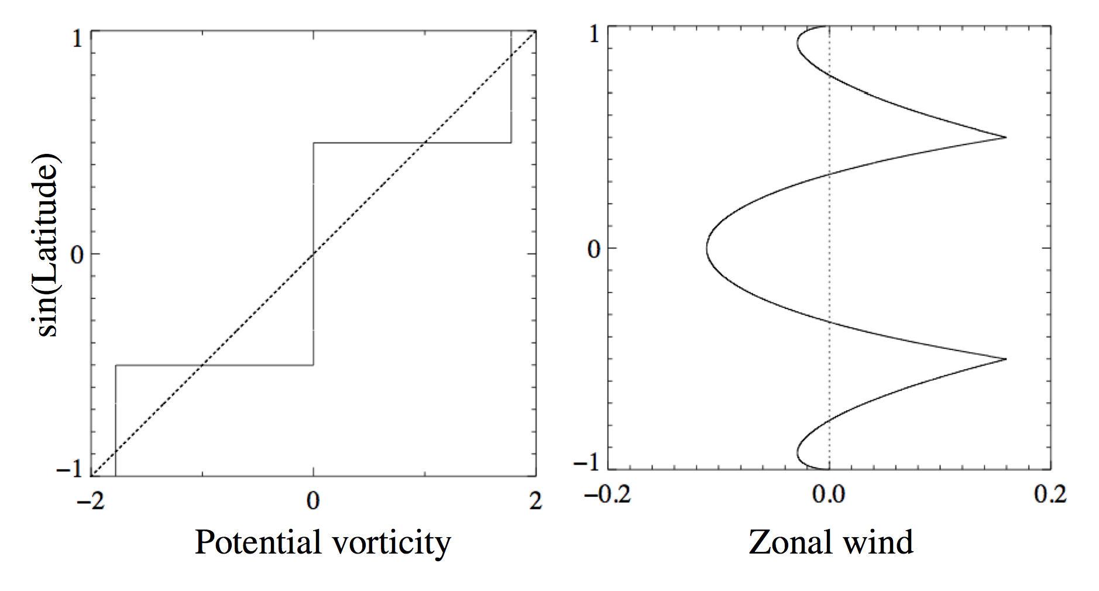
…and the relationship between PV and winds on rapidly rotating planets implies that when you have PV strips, you have jets
Scott (2010)

Slide 18
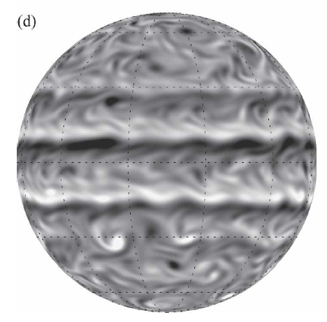
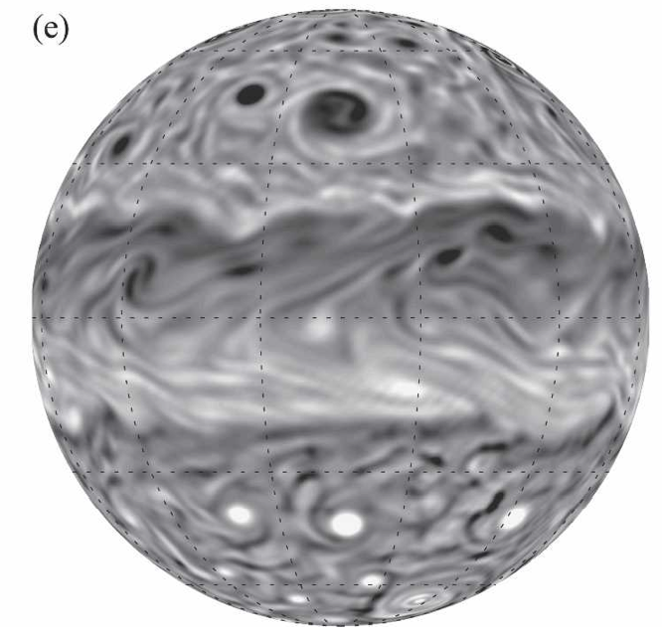
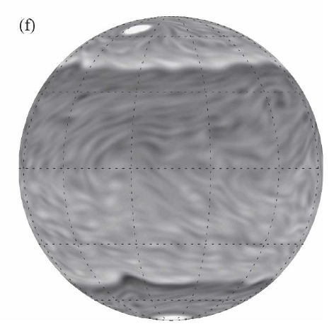
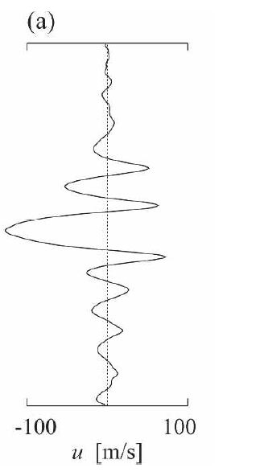
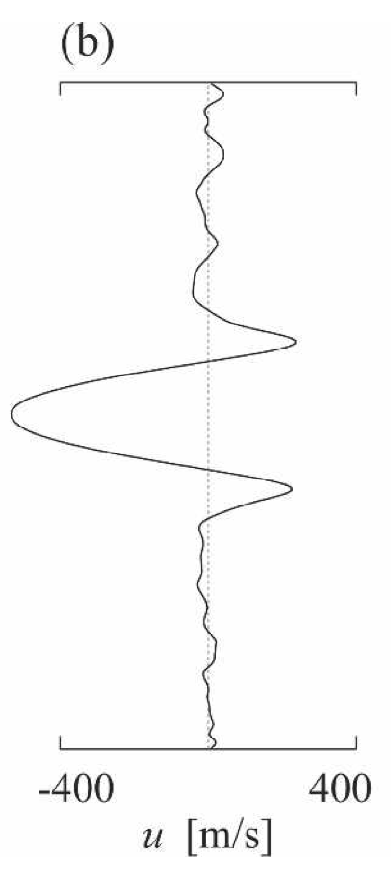
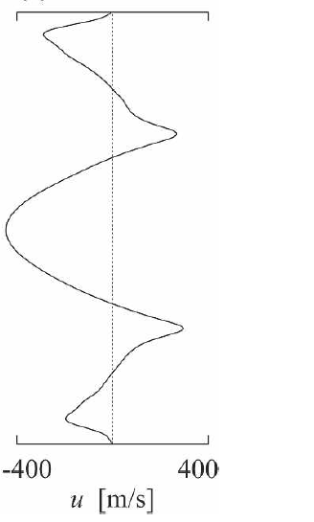
The PV staircases in these models imply zonal jet formation
Jupiter
Saturn
Uranus/Neptune
Scott & Polvani (2007); Showman (2007); Cho & Polvani (1996)
Bands and zonal jets spontaneously emerge, including an equatorial jet. Problem is the equatorial jet is generally westward!

Slide 19
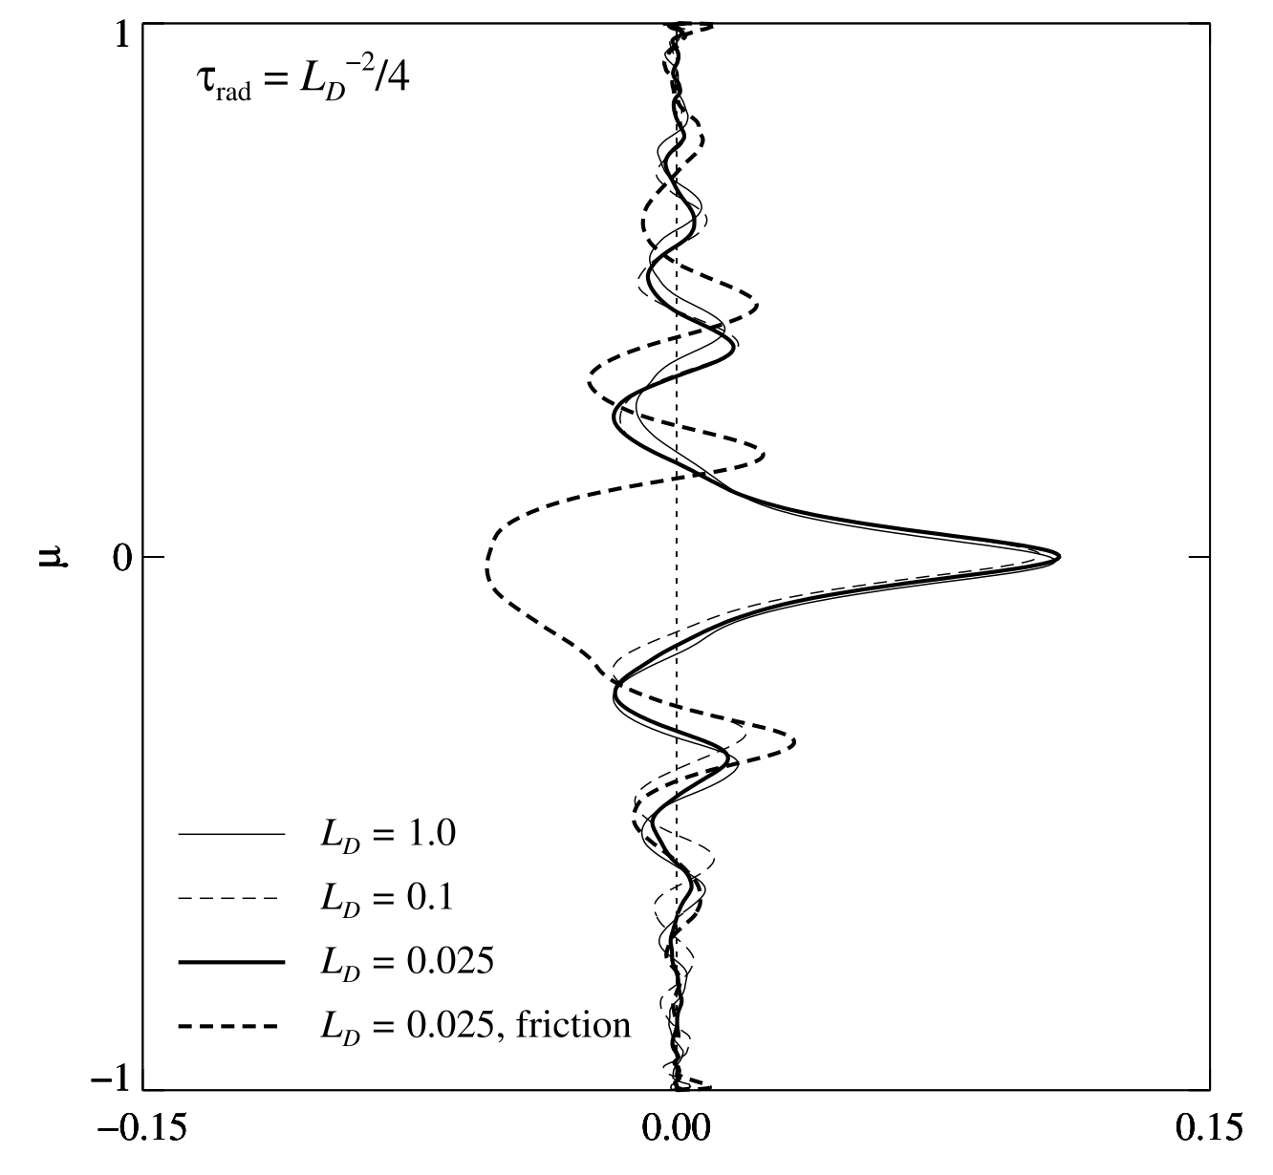
Superrotation can occur in shallow-water models
But the necessary ingredients that allow this to occur remain poorly understood, as does the dynamical mechanism. Thus the relevance to Jupiter/Saturn remains unclear.
sin(latitude)
Zonal wind
Scott & Polvani (2008)

Slide 20
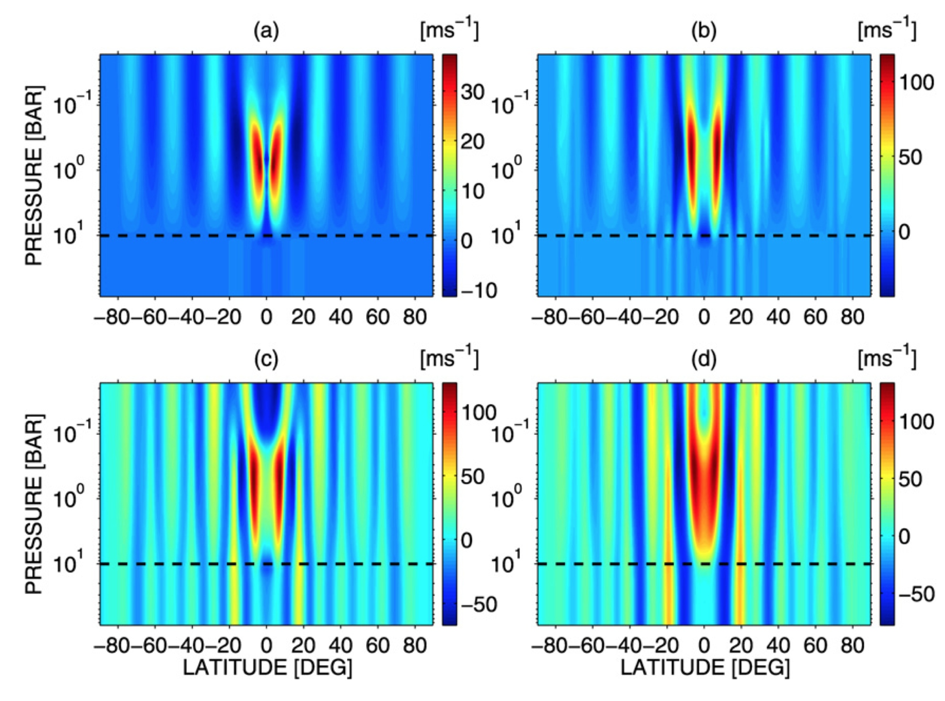
3D atmosphere models show that multiple jets can occur in response to baroclinic instabilities in the weather layer, and that deep jets can arise from shallow forcing via “downward control”
Lian & Showman (2008)

Slide 21
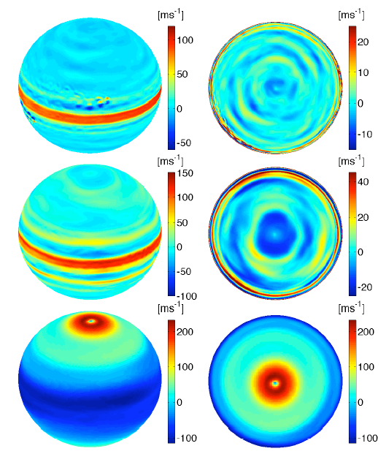
3D models can now demonstrate a transition from superrotation on Jupiter/Saturn, to subrotation on Uranus/Neptune, with jet profiles similar to those observed on all four planets.
Jupiter
Saturn
Lian & Showman (2010)
Uranus/ Neptune

Slide 22
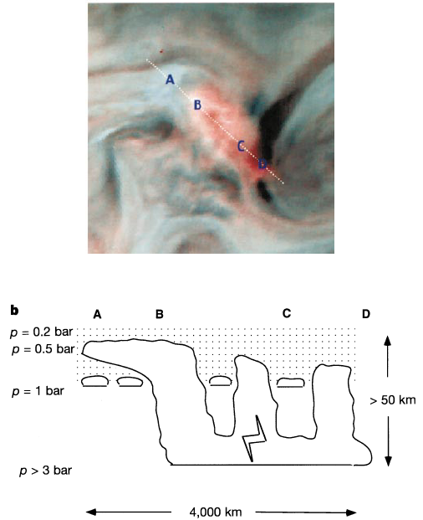
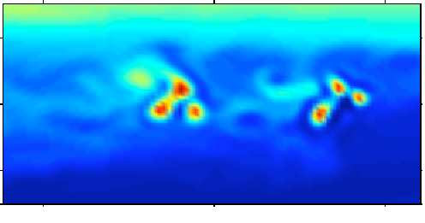
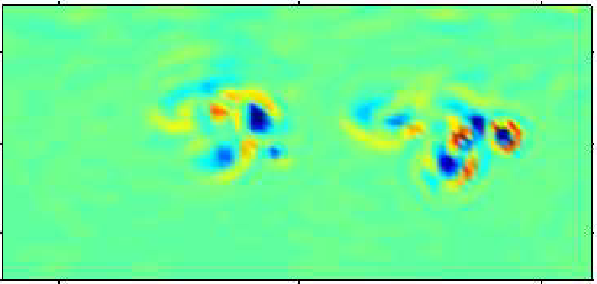
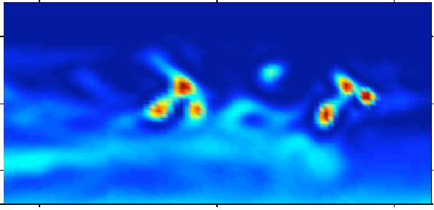
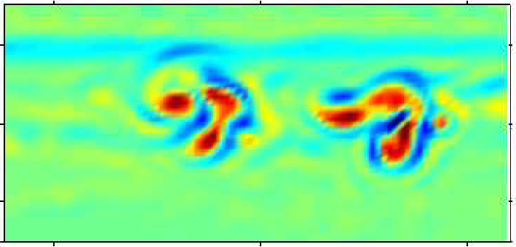
Storms
Global GCM with hydrological cycle
Observations (Galileo orbiter)
Temperature
(5 bars)
Vertical
Velocity
Humidity
Vorticity
(1 bar)
Gierasch et al. (2000)
Lian & Showman (2010)

Slide 23

Lian & Showman (2010)

Slide 24
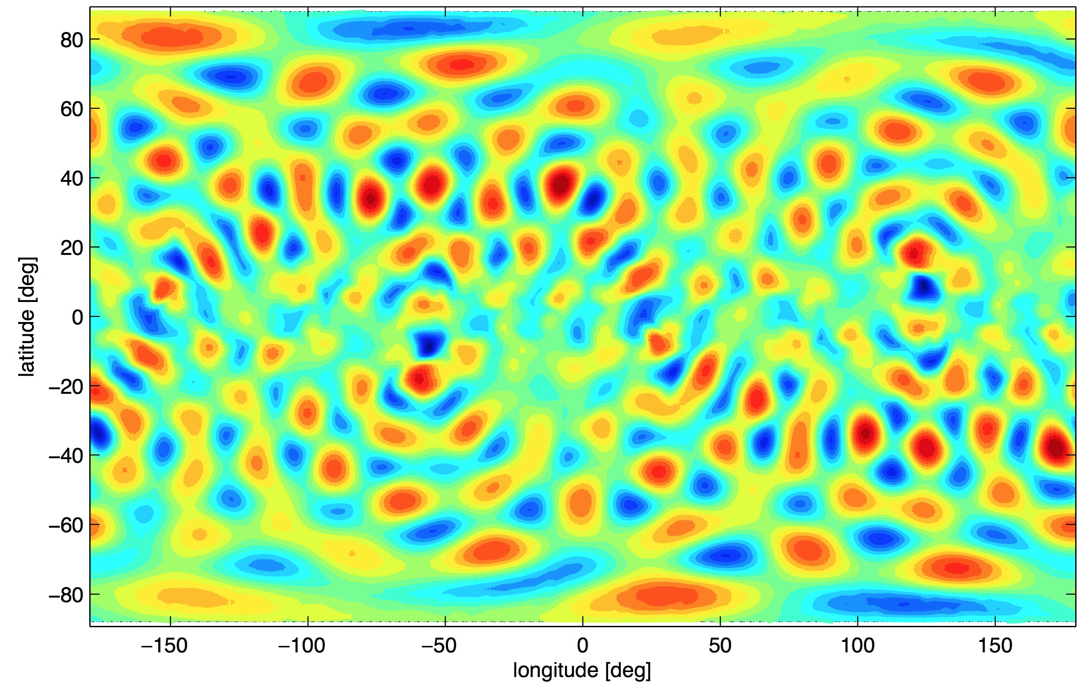
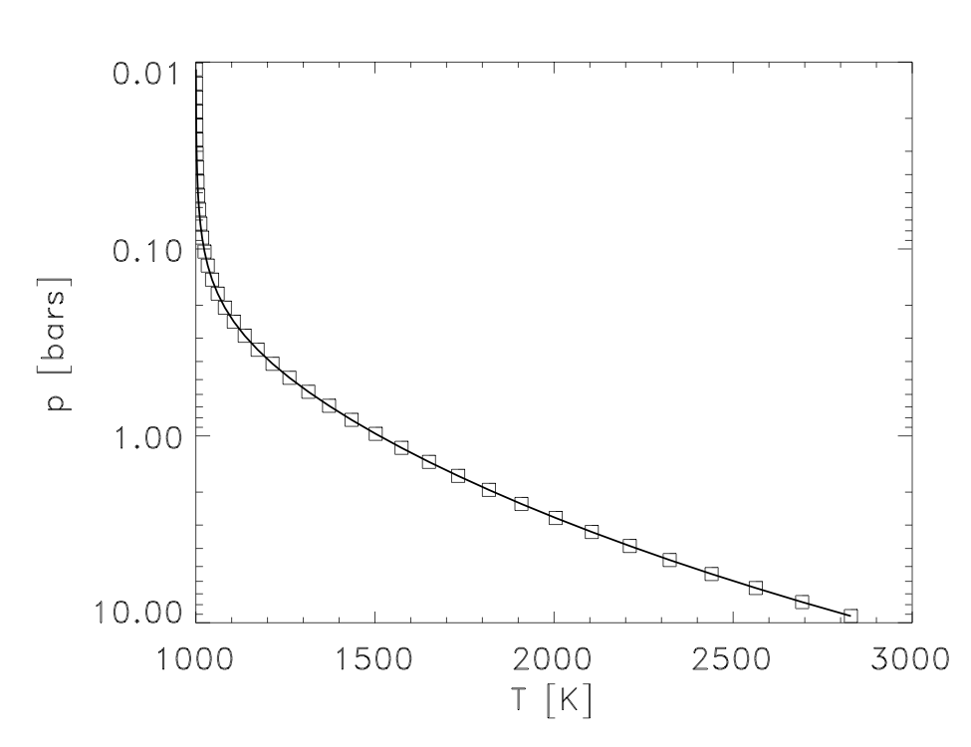
Goal: determine the 3D atmospheric circulation that results from isotropic convective forcing near the radiative-convective boundary.
Solve global 3D primitive equations in a stratified atmosphere with MITgcm. Domain from 0.01-10 bars.
Parameterize convection by adding isotropic thermal perurbations at total wavenumber 20 to bottom of model.
Radiation parameterized by Newtonian cooling:
Systematically vary τ_{rad} to span the range of brown dwarfs from hot (short τ_{rad}) to cooler (long τ_{rad})
Photospheric
pressures
RCB
Thermal forcing

Slide 25
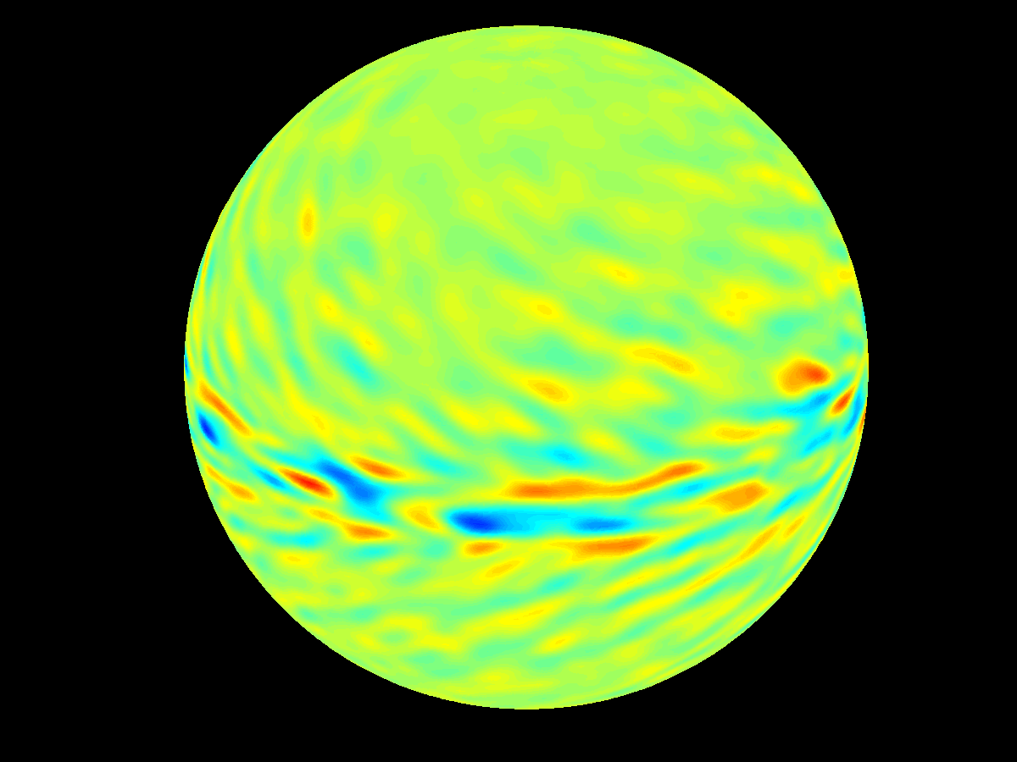
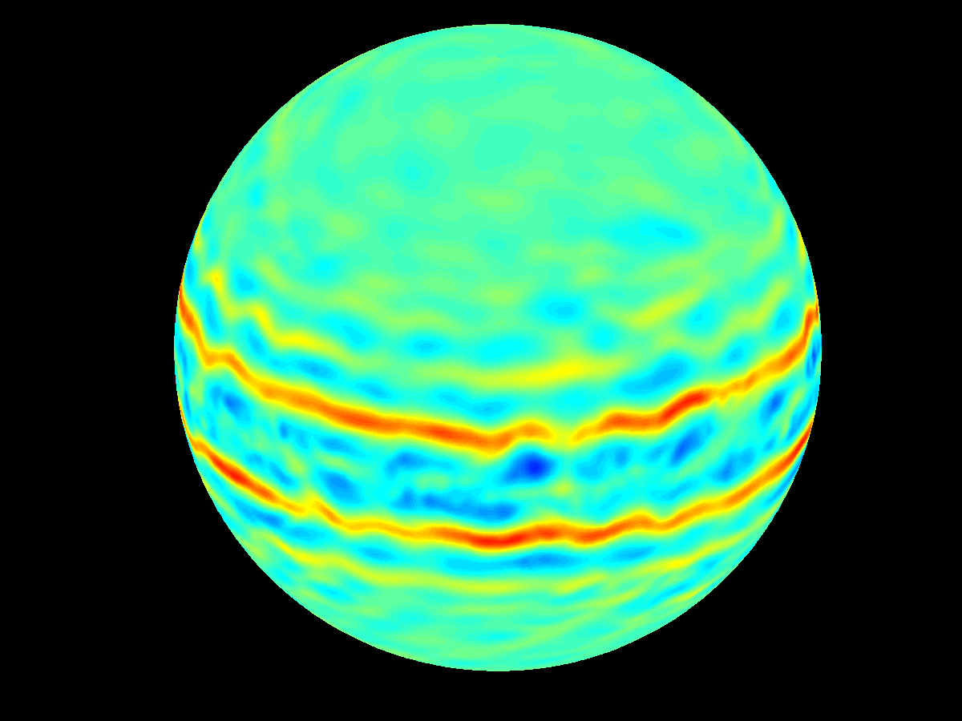
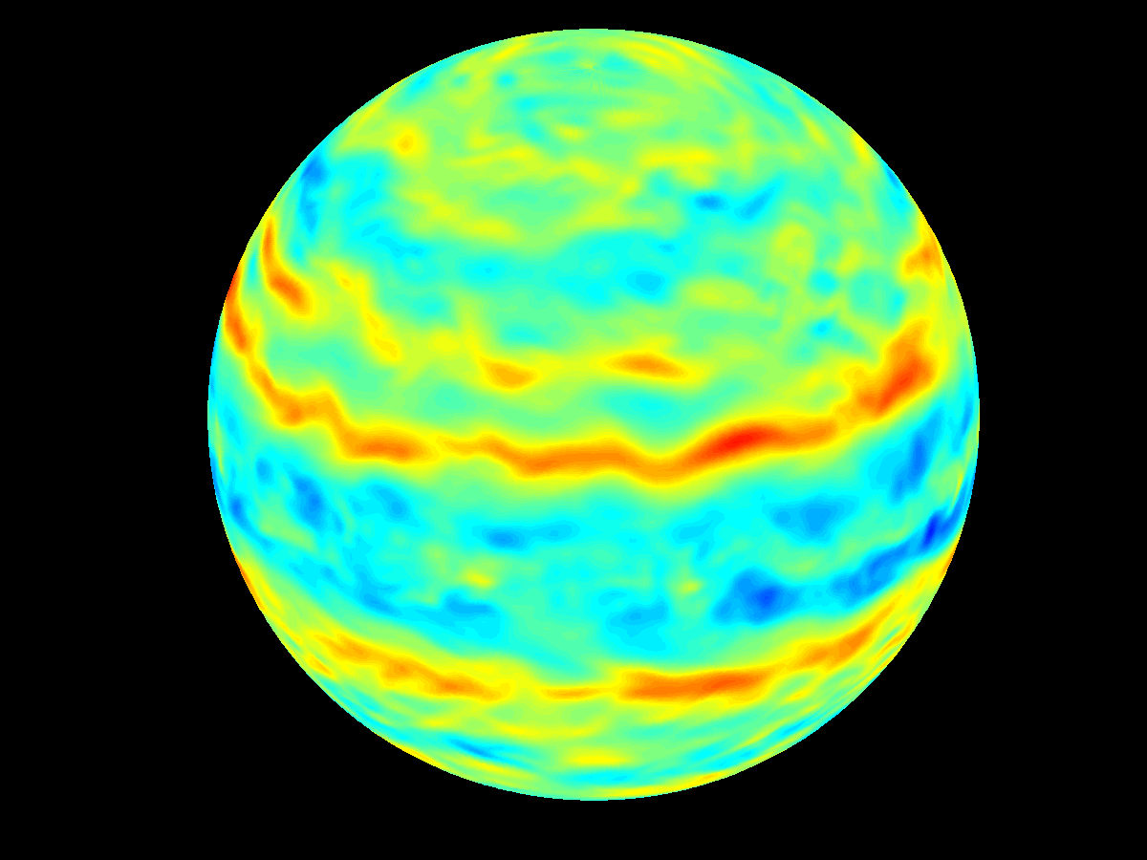
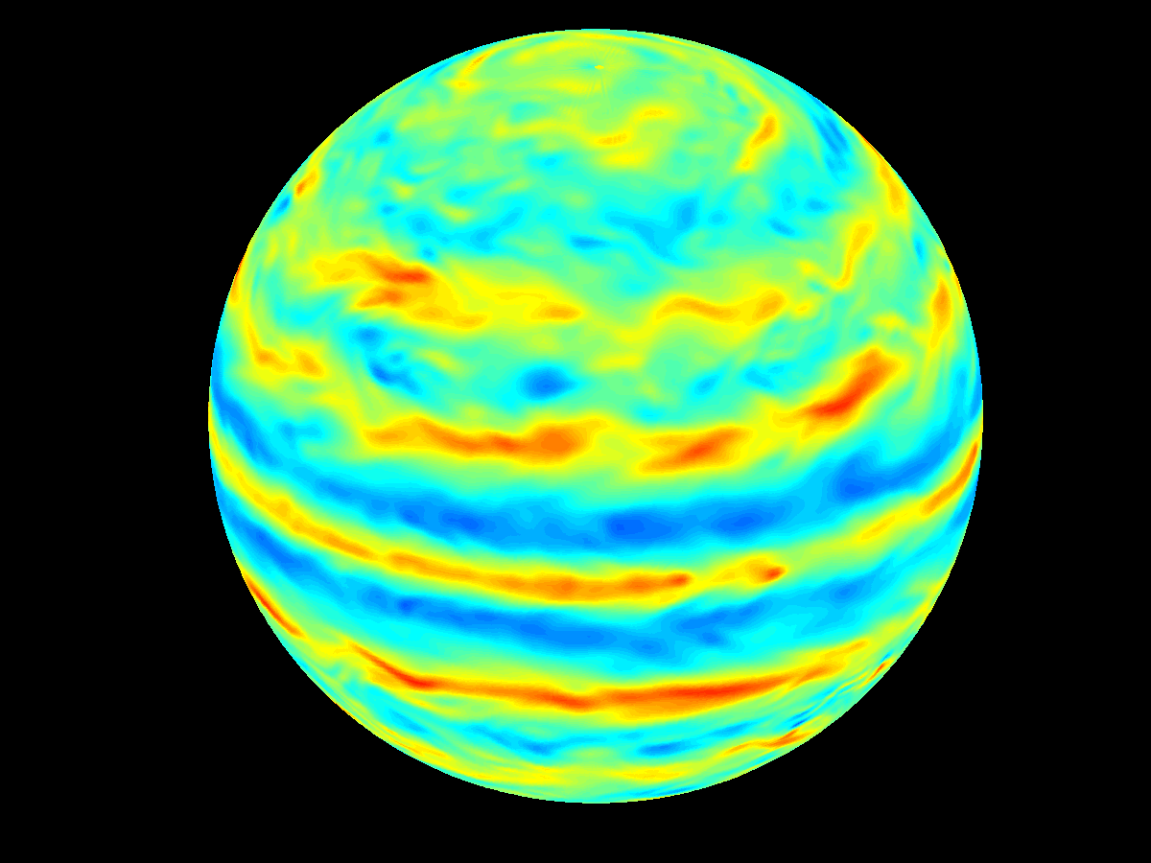
τ_{rad} = 10⁴ sec
τ_{rad} = 10⁵ sec
τ_{rad} = 10⁶ sec
τ_{rad} = 10⁷ sec
Notes:
Runs 23-26 at level 20 (at a pressure near 0.35 bar or so)

Slide 26
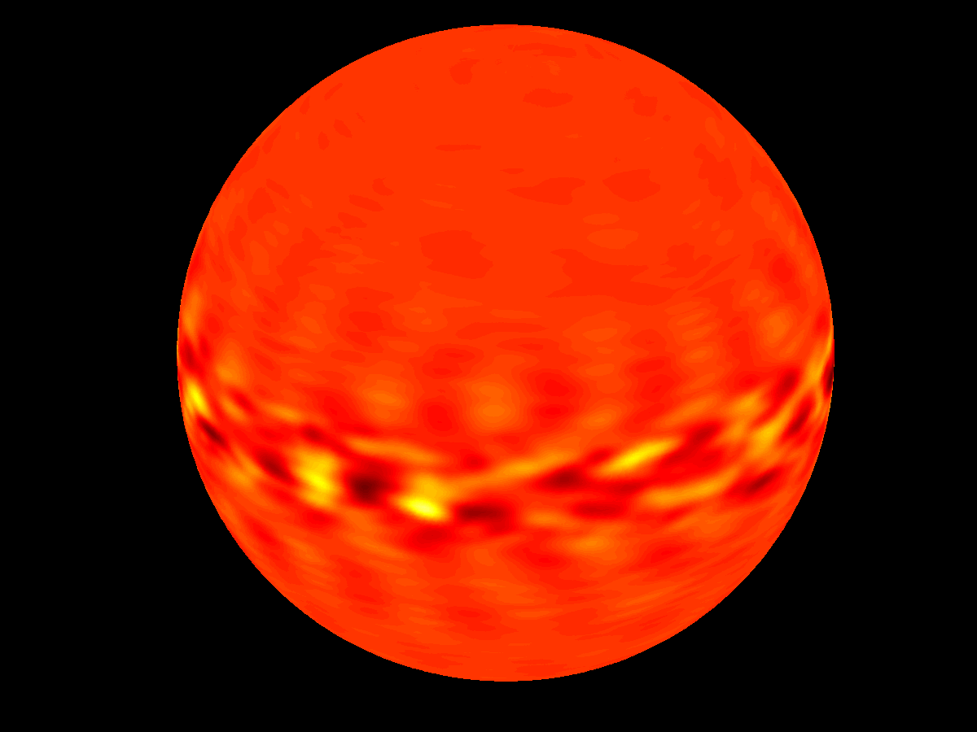
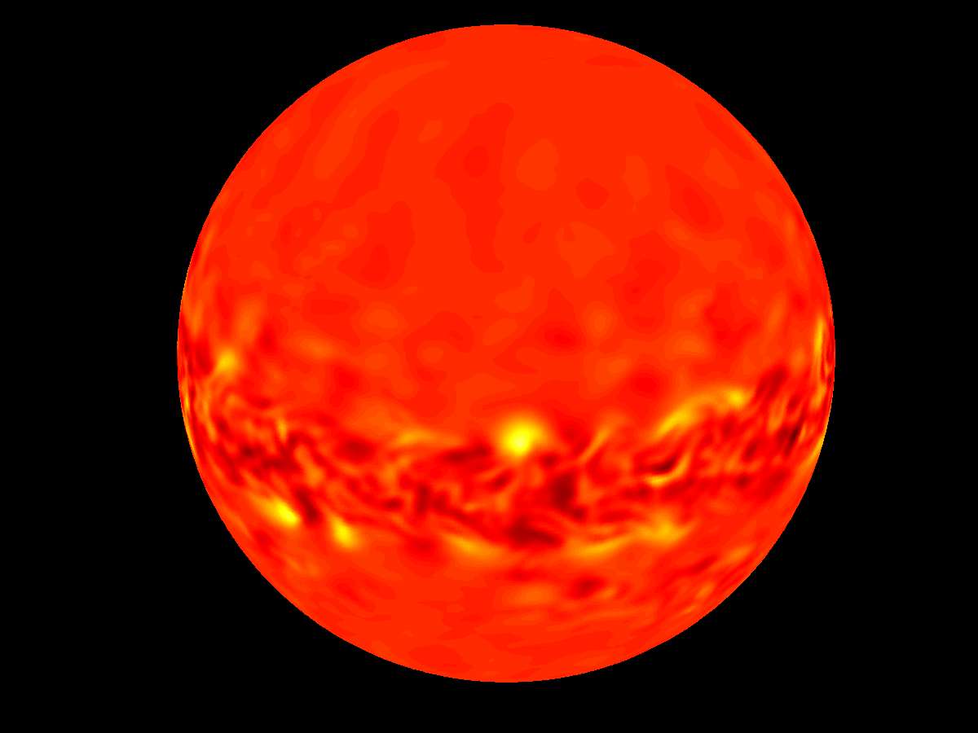
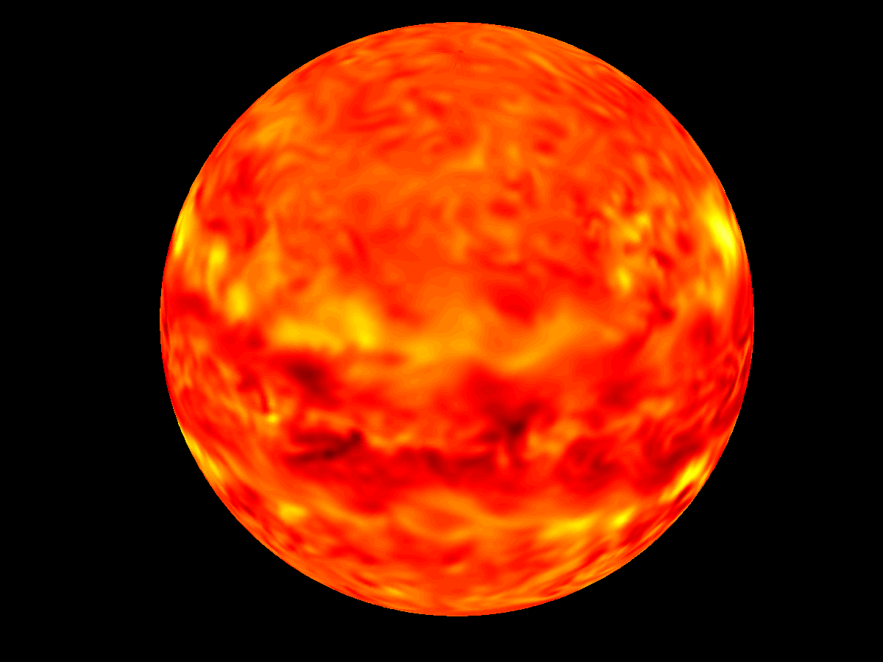
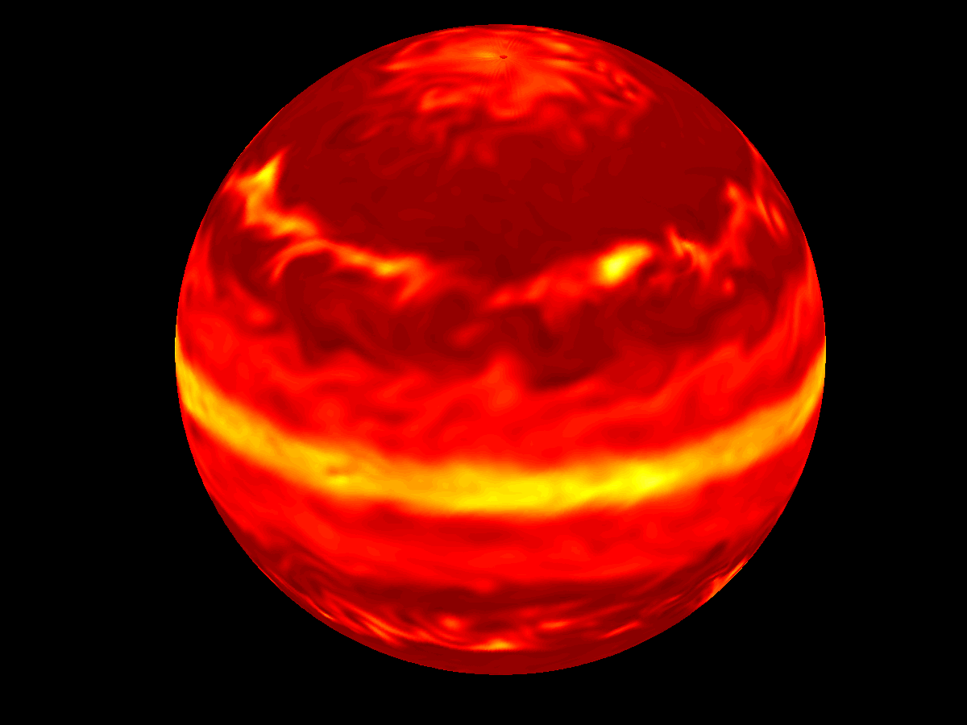
τ_{rad} = 10⁴ sec
τ_{rad} = 10⁵ sec
τ_{rad} = 10⁷ sec
τ_{rad} = 10⁶ sec
Notes:
Run 23-26 at level 20

Slide 27
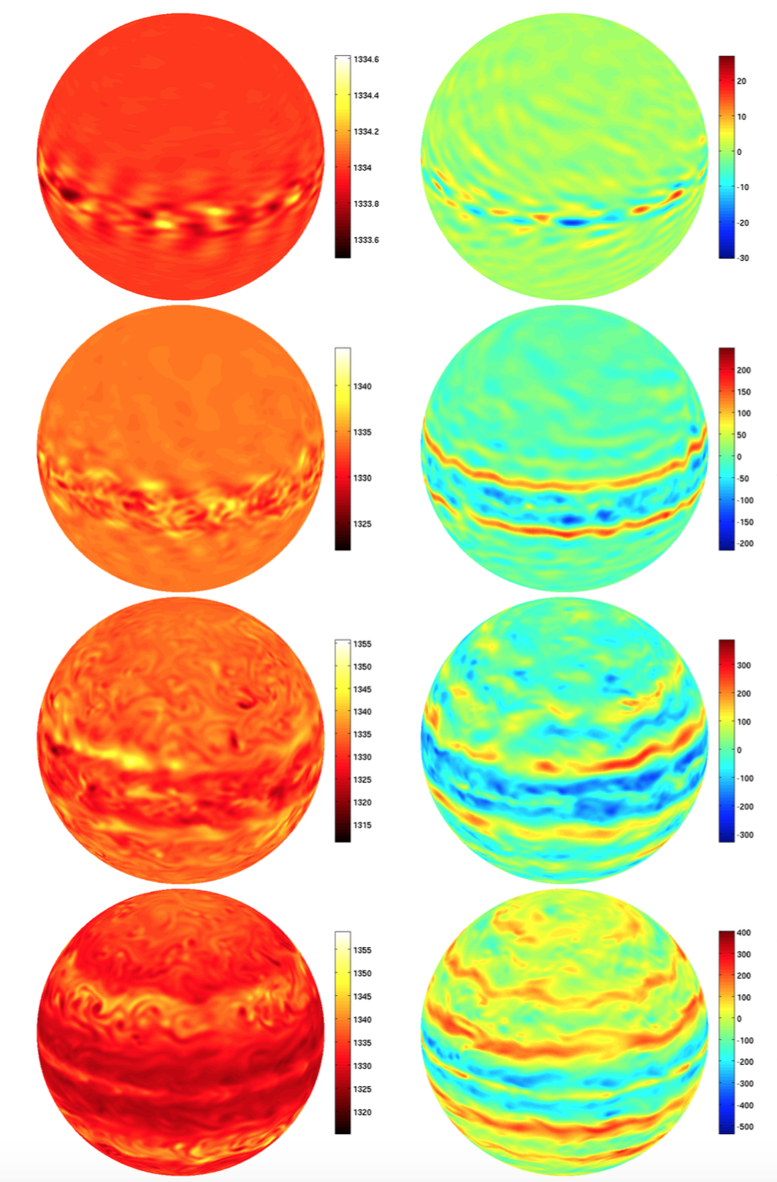

Slide 28
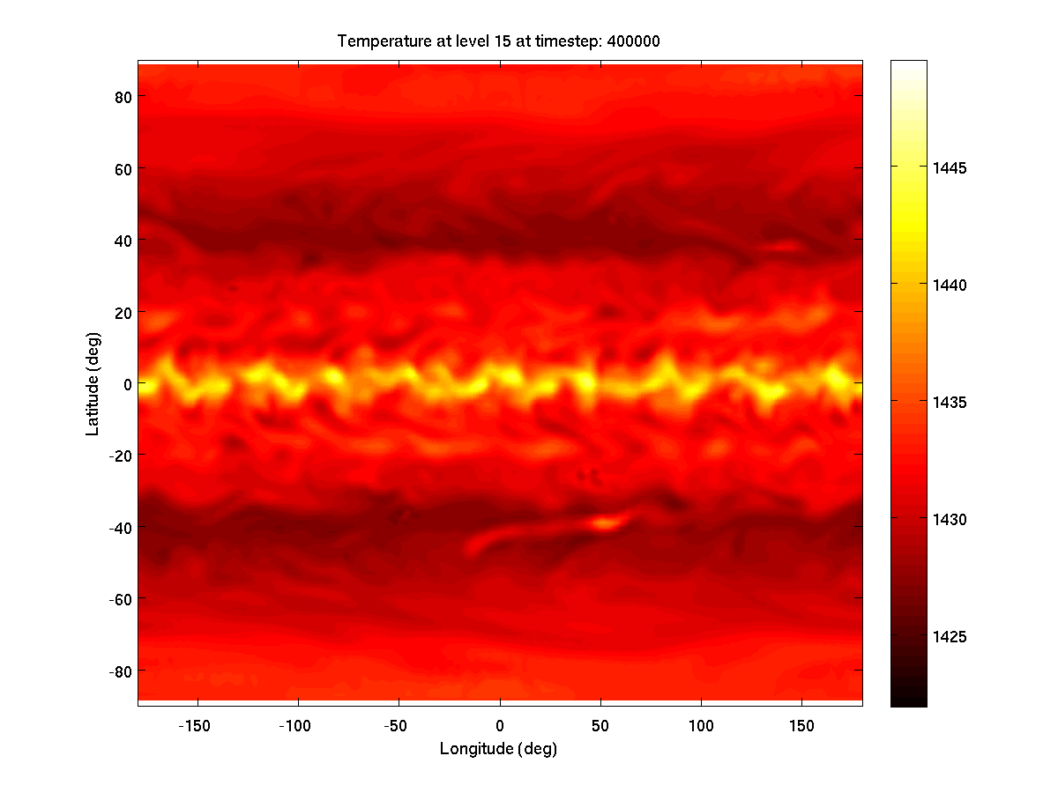
Showman et al. (in prep)

Slide 29
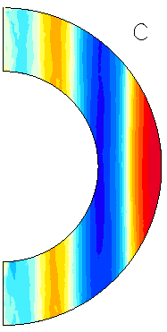
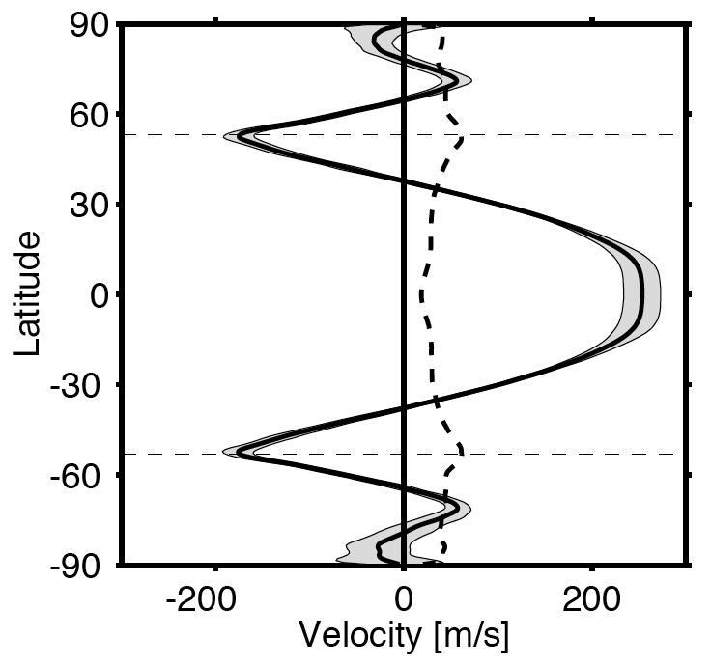
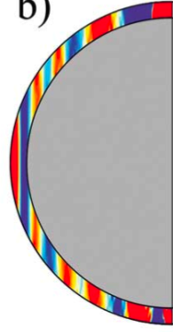
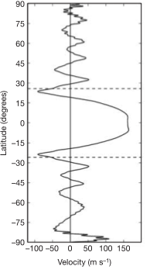
Deep convection models
Boussinesq models
Thick shell
(Christensen 2001, 2002;
Aurnou & Olson 2001;
Kaspi et al. 2009,
Jones & Kuzanyan 2009,
Showman et al. 2011, etc)
Thin shell
(Heimpel et al. 2005;
Heimpel & Aurnou 2007;
Aurnou et al. 2008)

Slide 30
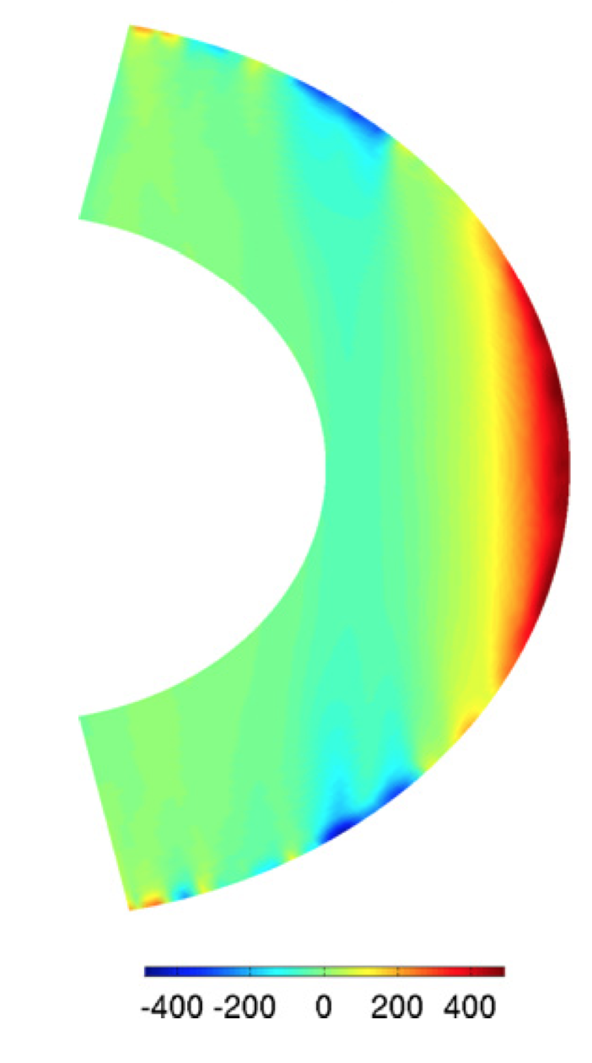
Many deep models now include the radial density gradient
Kaspi et al. (2009); Jones & Kuzanyan (2009); Showman et al. (2011); Gastine & Wicht (2012); Gastine et al. (2013); Radav et al. (2013)

Slide 31
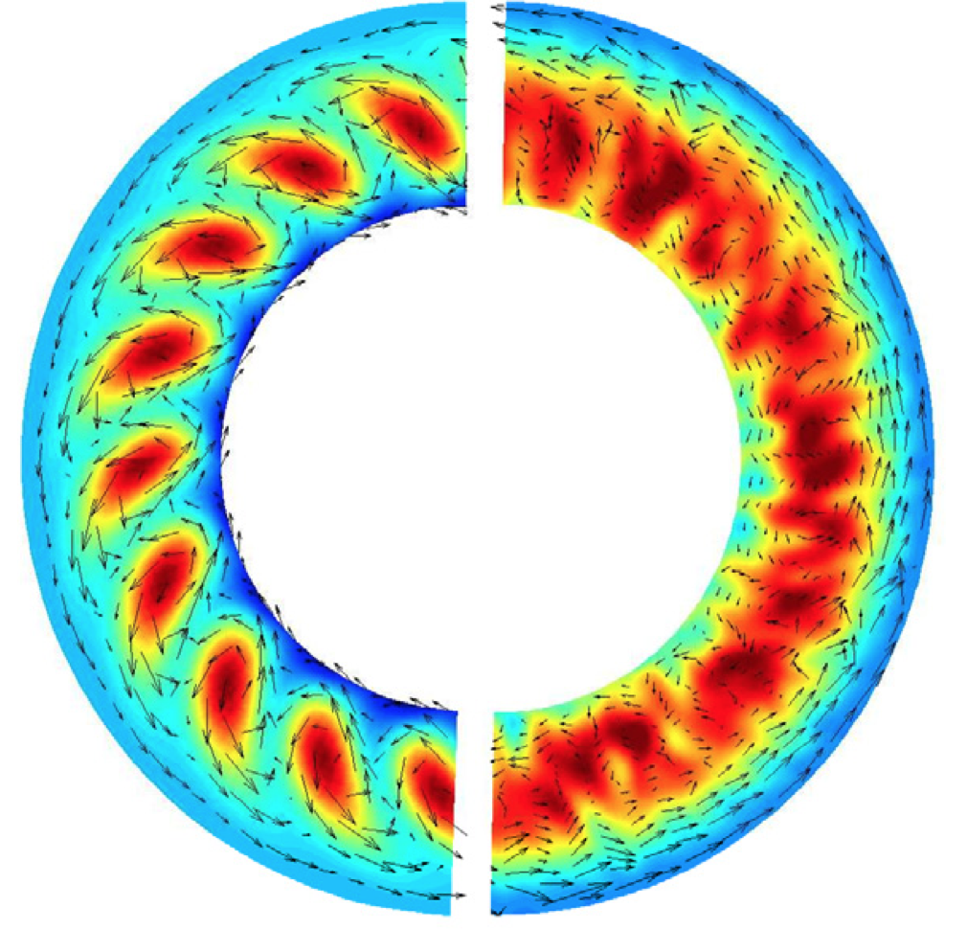
Superrotation in convection models results from correlations between zonal and (cylindrically) outward velocity components
Showman et al. (2011)

Slide 32
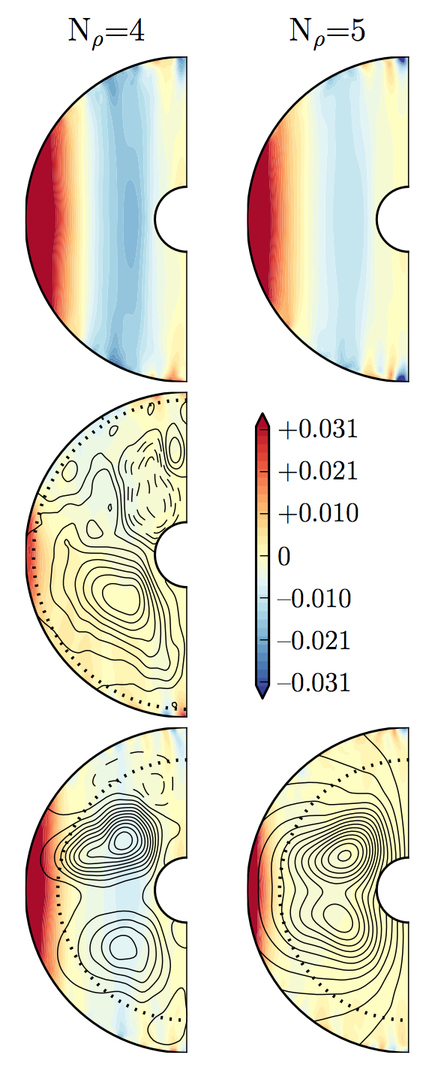
Models including radial gradient in electrical conductivity
High-latitude jets are largely suppressed, but the equatorial jet still occurs
Duarte et al. (2013)

Slide 33
Conclusions
Zonal jets dominate the atmospheric circulation of all known rapidly rotating planets, including Earth, Mars, and the four giant planets. Earth and Mars have a subtropical and an eddy-driven jet in each hemisphere. Jupiter and Saturn have ~10 jets in each hemisphere; evidence indicates they are eddy driven.
On Earth and Mars, the subtropical jet results from the Hadley circulation. The eddy-driven jet results from Rossby-wave generation by baroclinic instabilities in the midlatitudes. As the Rossby waves propagate north and south away from the latitude of wave generation, they transport momentum back into that region, driving the jet.
On Jupiter and Saturn, several interacting feedbacks help to maintain the zonal jets. Specifically, the jets organize the eddies in such a way that the eddies maintain the jets. One feedback involves shear straining of eddies by the mean flow. Another involves the inhomogeneous mixing of the fluid by eddies, and its effect on the zonal jets. Both feedbacks cause the spontaneous emergence of zonal jets from random forcing.
Evidence indicates that brown dwarfs have active atmospheric circulations. The above feedbacks should occur on brown dwarfs too, suggesting they likely have zonal jets. Nevertheless, the details may differ. The strong radiative damping (due to short radiative time constants) may suppress zonal jets in certain cases.

Slide 35
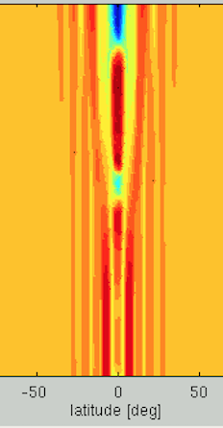
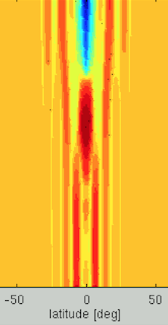



Evolution of equatorial zonal-mean zonal wind
Time
Pressure
Latitude
Latitude
Latitude
Latitude
Latitude

Slide 36

Evolution of equatorial zonal-mean zonal wind

Slide 37

Mechanism involves a wave-mean-flow interaction
Baldwin et al. (2001),
Plumb (1984)

