Slide 1
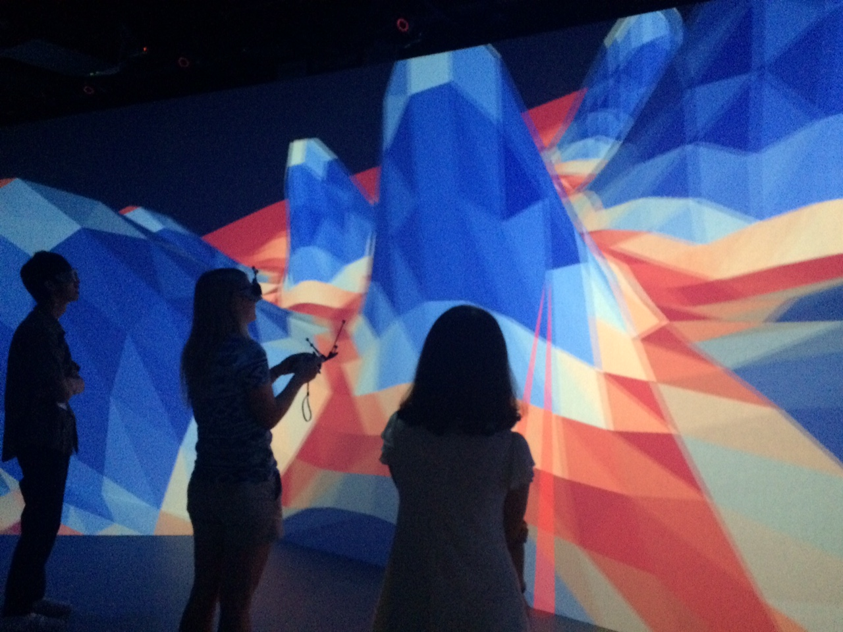



The Patterns Behind Patterns
Stephanie Dodson, Ryoji Jinushi, Elizabeth Makrides,
Daiki Oyagi and Kunrui Wang

Slide 2

We say “ありがとう”
Thank you to our hosts at Kobe University, in particular Usui-sensei, Takahashi-sensei and Miyake-sensei
Thank you also to Kaya-sensei who initiated this summer school
And special thanks to Meno-sensei and Morishita-sensei for their assistance with 3D visualizations here and in the CAVE

Slide 3
Introduction to Pattern Formation
In our project we explore localized patterns on the plane
These patterns appear in a variety of physical contexts, such as fluid systems, buckling and vegetation growth
Understanding these patterns may lead to advances in our ability to predict and control physical processes such as crystallization
Patterns are solutions to partial differential equations (PDEs) and include spots and stripes, rhomboids and hexagons

Slide 4
Examples from Physical Systems
1
Bucking in thin structures¹
2
Plane Couette flow²
3
Nonlinear optics: cavity solitons³
4
Vegetative growth patterns⁴
1. Hunt et al., 2000; 2. Schneider et al., 2010; 3. McSloy et al., 2002; 4. Meron, 2012.

Slide 5
Our Model System
The Swift-Hohenberg equation
For stationary solutions,
We can vary the parameters μ and ν and also change the nonlinearity to model different physical systems
Finally, we can consider different boundary conditions (periodic, Neumann or combination)

Slide 6
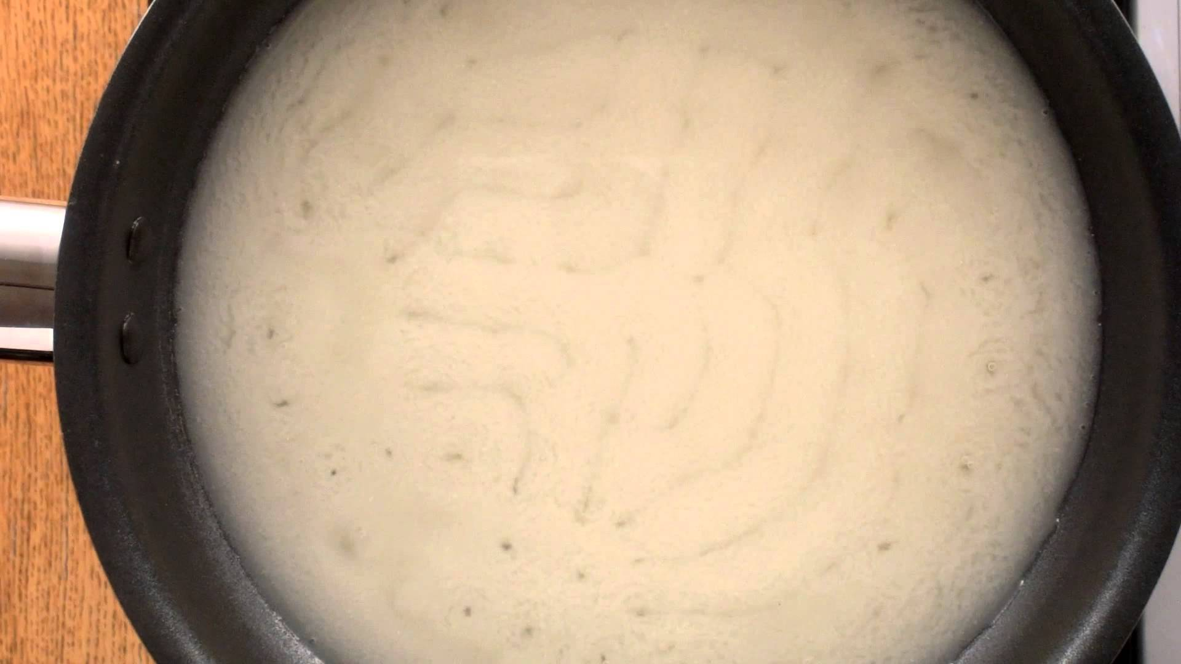
Meaning of Equation
The Swift-Hohenberg equation
https://www.youtube.com/watch?v=_IYHT5jAInc

Slide 7

Main Tool: Bifurcation Diagram
Solution Norm
Change in parameter
Each point corresponds to a solution
Shows how change in parameter affects solution

Slide 8
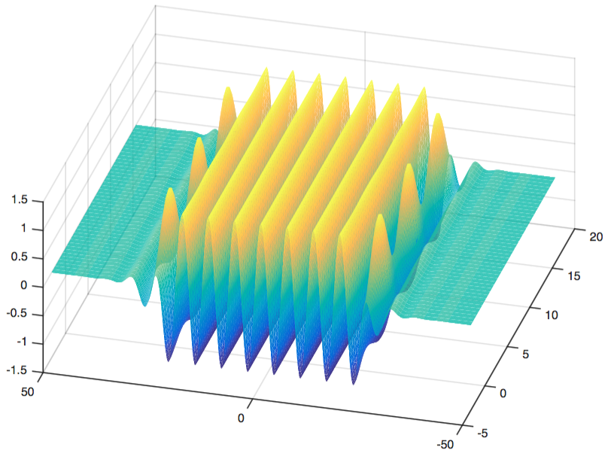
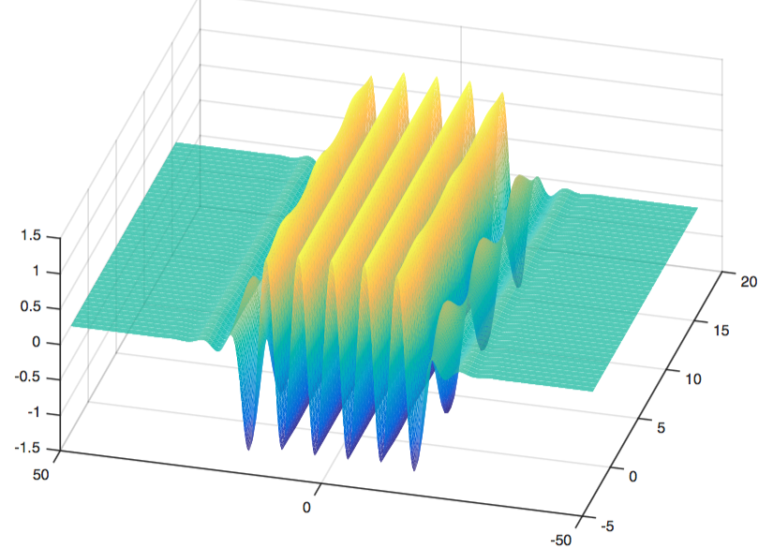
Main Tool: Bifurcation Diagram

Slide 9
Numerical Solutions
Computing the solutions numerically:
  Need to discretize the operators
  Impose boundary conditions (BC)
2nd order Finite Differences (FD) with Neumann BC
Fourier (spectral) with periodic BC on N grid points

Slide 10
Two Cases Studied Here
Nonlinearity 1:
Patterns:
Rhomboids
Hexagons
Discretization:
Fourier – periodic
Fourier – periodic
Nonlinearity 2:
Patterns:
Stripes and spots
All stripes or spots
Discretization:
Fourier – periodic
FD – Neumann
Fourier
FD
Fourier
Fourier

Slide 11
Numerical Continuation
Formulate the problem as
Our task: given an initial solution at find a manifold of solutions connected in parameter space
We proceed via a series of predictor-corrector steps
Predictor: find a vector in the null space of and make step
Corrector: use a root finding method in the constrained space
which is orthogonal to the predictor

Slide 12
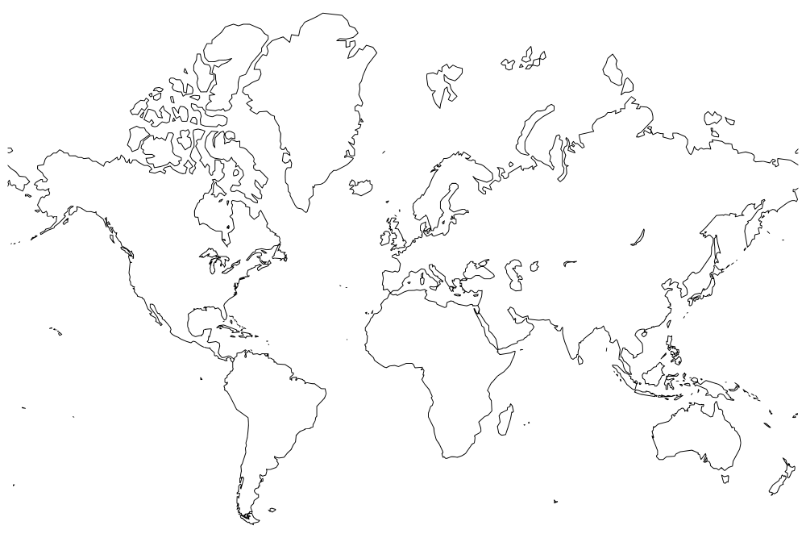
Resource use across continents
Visualizations conducted using the π-CAVE and resources at Kobe University
Computations completed on Oscar, the supercomputer at Brown University

Slide 13
And now our results … back to the videos!

Slide 14
Physical Interpretations of .
In general, corresponds to the primary control parameter
System Parameter
Physical System
Buckling, geologic folding
Plane Couette flow
Optical cavity solitons
Vegetation growth
Strength of compressive load
Reynolds number
Intensity of background field
Precipitation

Slide 15
Physical Interpretations of .
Parameter controls the strength of the nonlinearity
Correspondence less exact—generally combination of system parameters—but examples include:
System Parameter
Physical System
Buckling, geologic folding
Optical cavity solitons
Nonlinearities in foundation,
strength of restiffening
Cooperativity parameter

Slide 16
Comparison of bifurcation diagrams
Hexagons, small domain
Hexagons, large domain

