Slide 1
RMSE の波数解像度依存性
 | planetary radiation |  |  |  | solar radiation
Δk cm⁻¹ | upflx W m-2 | dnflx W m-2 | flxcnv W m-3 | tend K s-1 | upflx W m-2 | dnflx W m-2 | flxcnv W m-3 | tend K s-1
10 | 1.98 | 3.28 | 7.99e-4 | 6.55e-5 | 3.73e-1 | 1.11 | 1.40e-4 | 1.55e-5
5 | 2.45 | 1.79 | 7.41e-4 | 1.33e-5 | 2.66e-1 | 4.54e-1 | 9.59e-5 | 1.63e-5
2 | 1.15 | 9.55e-1 | 3.42e-4 | 6.00e-5 | 3.29e-3 | 1.29e-1 | 4.28e-5 | 5.38e-6
1 | 4.88e-1 | 6.53e-1 | 1.67e-4 | 3.26e-5 | 5.67e-2 | 1.11e-1 | 4.17e-5 | 3.78e-6
0.5 | 1.15e-1 | 6.56e-2 | 2.09e-5 | 7.10e-6 | 5.03e-4 | 1.42e-2 | 3.24e-6 | 3.40e-7
0.2 | 4.65e-1 | 3.91e-1 | 5.33e-5 | 1.70e-5 | 3.15e-3 | 2.13e-2 | 9.34e-6 | 9.38e-7
0.1 | 1.15e-1 | 6.56e-2 | 2.09e-5 | 7.10e-6 | 5.03e-4 | 1.42e-2 | 3.24e-6 | 3.40e-7
0.05 | 3.94e-2 | 8.18e-2 | 1.05e-5 | 5.90e-6 | 1.65e-4 | 3.15e-3 | 9.34e-7 | 1.83e-7
0.02 | 1.12e-2 | 4.77e-2 | 3.45e-6 | 5.63e-6 | 2.12e-5 | 9.47e-4 | 1.36e-7 | 3.07e-7
0.01 | 5.29e-3 | 1.58e-2 | 1.57e-6 | 1.84e-6 | 3.02e-7 | 2.28e-4 | 2.99e-8 | 5.68e-8
0.2+2* | 4.65e-1 | 3.91e-1 | 5.33e-5 | 1.70e-5 | 3.29e-3 | 1.41e-1 | 4.24e-5 | 3.58e-6
0.1+1* | 1.15e-1 | 6.56e-2 | 2.09e-5 | 7.10e-6 | 5.67e-2 | 1.19e-1 | 4.17e-5 | 2.88e-6
*解像度
切り替え
は 3500 cm⁻¹.

Slide 2
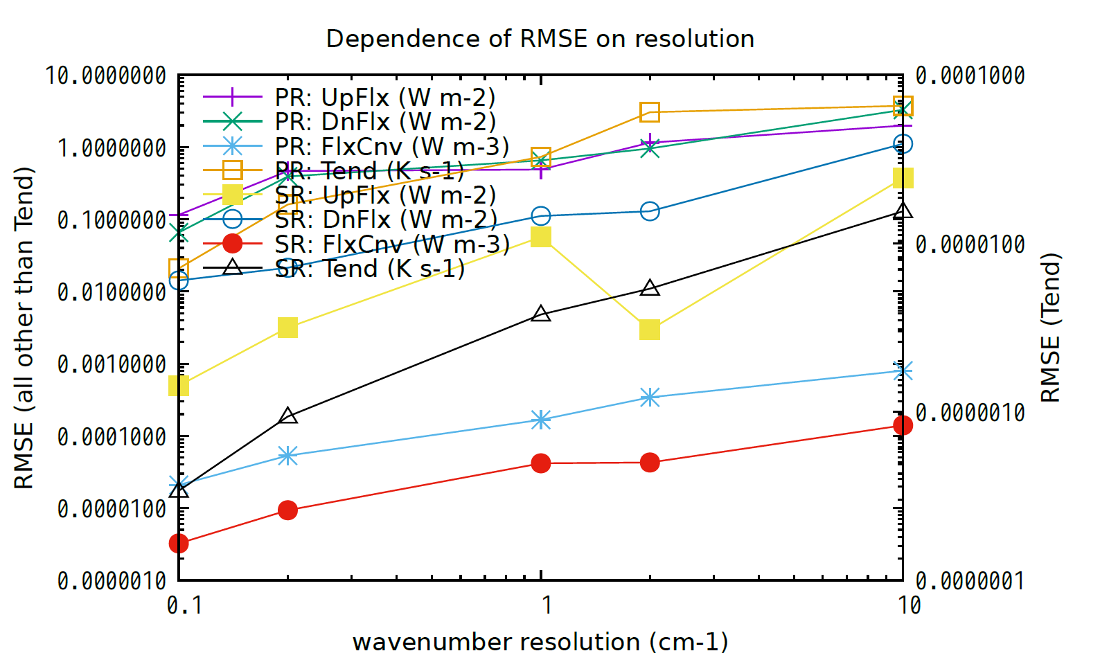
OLD

Slide 3
RMSE の波数解像度依存性
OLD
圧力範囲 p ≥ 10 hPa
Δk cm⁻¹ | upflx W m-2 | dnflx W m-2 | flxcnv W m-3 | tend K s-1 | upflx W m-2 | dnflx W m-2 | flxcnv W m-3 | tend K s-1
10 | 1.39 | 3.26 | 8.81e-4 | 5.30e-6 | 3.72e-1 | 1.23 | 1.55e-4 | 3.61e-7
2 | 1.01 | 1.04 | 3.79e-4 | 1.51e-6 | 3.13e-3 | 1.43e-1 | 4.75e-5 | 1.39e-7
1 | 5.09e-1 | 7.07e-1 | 1.84e-4 | 7.03e-7 | 5.67e-2 | 1.22e-1 | 4.62e-5 | 8.76e-8
0.2 | 3.85e-1 | 4.30e-1 | 5.87e-5 | 2.88e-7 | 3.05e-3 | 2.35e-2 | 1.04e-5 | 1.98e-8
0.1 | 1.15e-1 | 4.91e-2 | 2.14e-5 | 8.01e-8 | 4.73e-4 | 1.52e-2 | 3.59e-6 | 1.14e-8
0.1+1 *4000 cm⁻¹ | 1.15e-1 | 4.91e-2 | 2.14e-5 | 8.01e-8 | 6.01e-3 | 8.39e-2 | 2.24e-5 | 5.57e-8
0.1+1 *3500 cm⁻¹ | 1.15e-1 | 4.91e-2 | 2.14e-5 | 8.01e-8 | 6.01e-3 | 1.04e-1 | 2.38e-5 | 5.70e-8
*解像度切り替え波数.

Slide 4
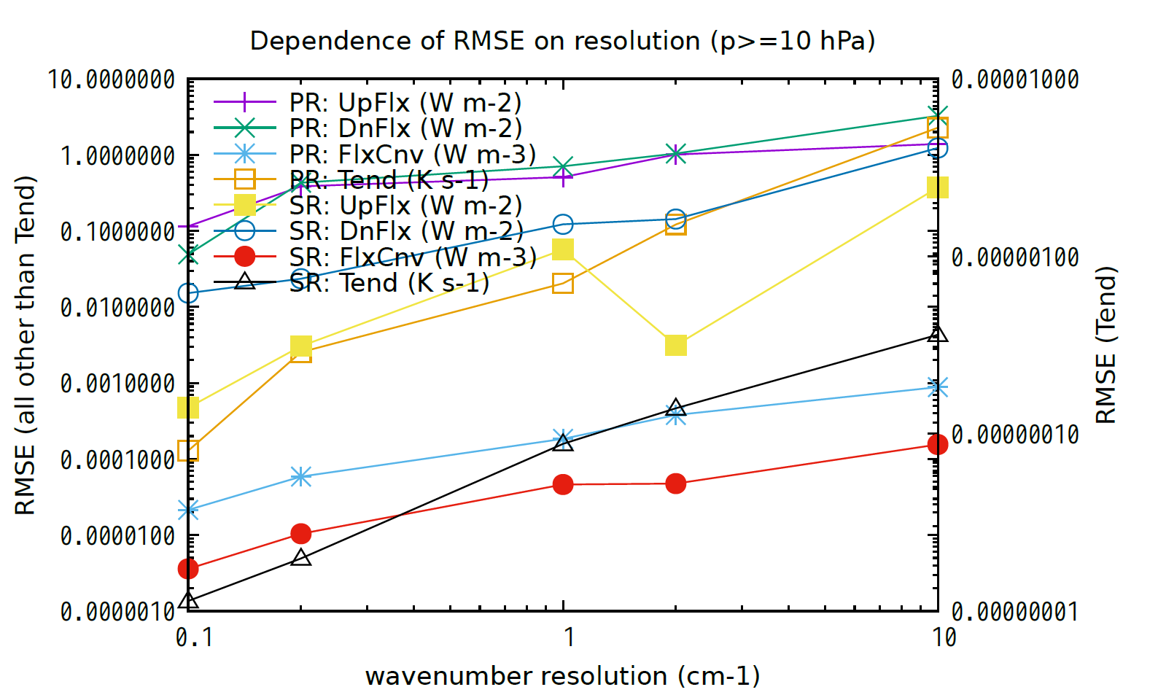
OLD

